Slide 1


BUILD A SINGLE AUTONOMOUS AI AGENT IN COPILOT STUDIO

Slide 2

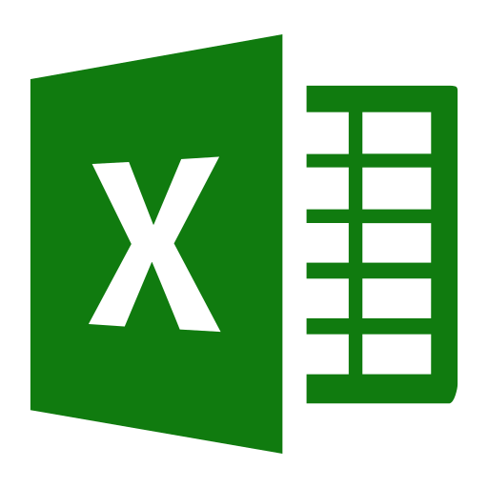

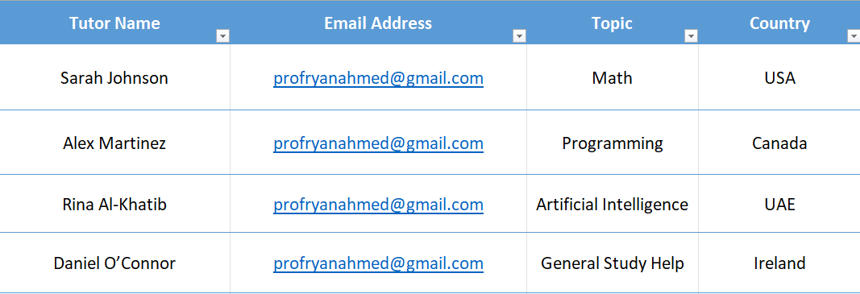
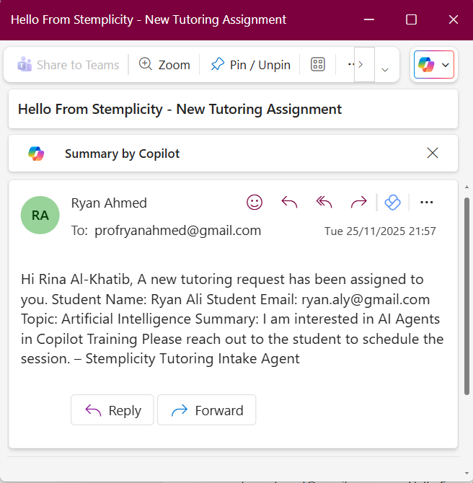

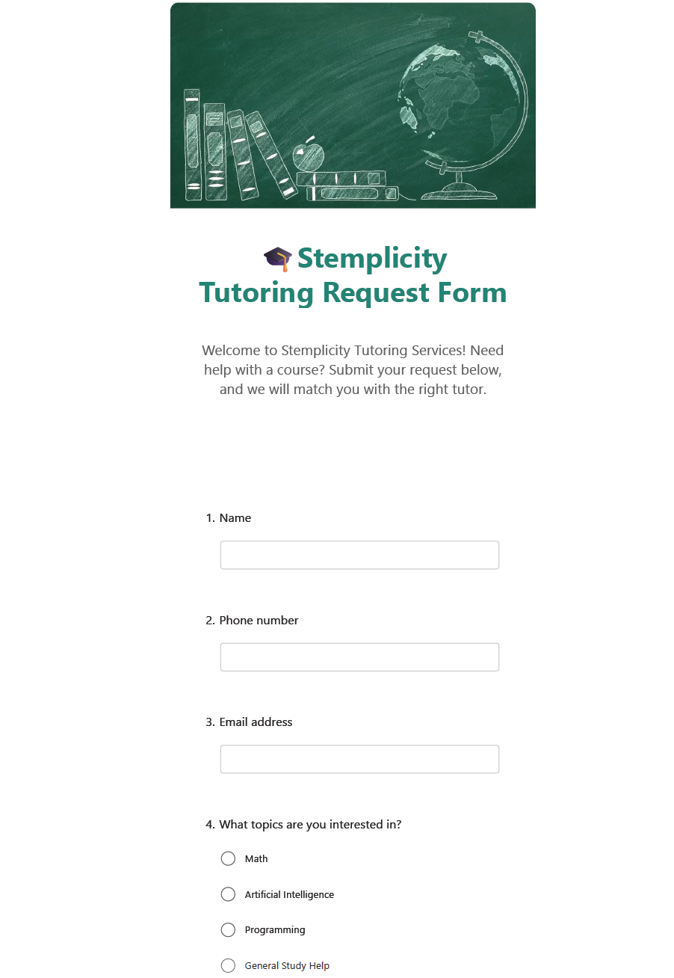
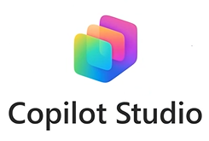
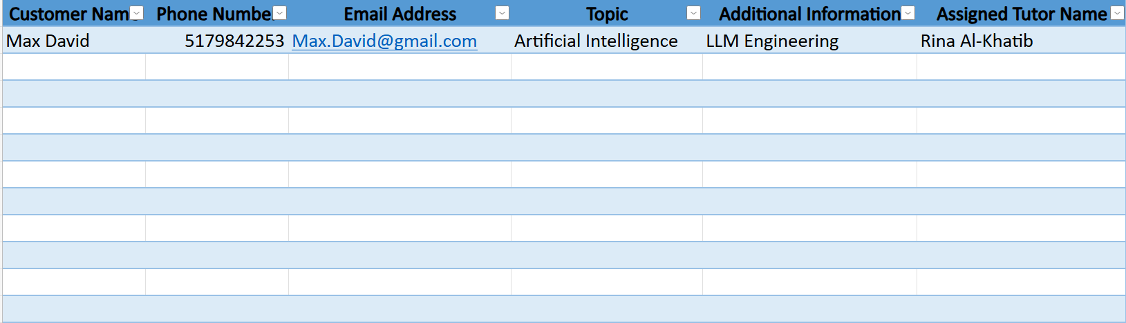
Project Overview
Tutors List
Draft/Send Email
Trigger
© All rights reserved for Dr. Ryan Ahmed @Stemplicity Inc.
Customers & Tutors Log
Autonomous AI Agent

Slide 3

Key Learning Outcomes
Build an Autonomous AI agent in Copilot Studio.
Master how to add advanced instructions to the agent with tool reference.
Automate drafting and sending emails with Copilot Studio
Automate updating excel sheets available on OneDrive.
Learn how to connect multiple Microsoft 365 tools (Excel, Outlook, Forms) to the Agent.
Build an end-to-end AI Automation workflows without human intervention.
© All rights reserved for Dr. Ryan Ahmed @Stemplicity Inc.

Slide 4
PRACTICE OPPORTUNITY

Slide 5

Practice Opportunity
In this exercise, you’ll enhance the Stemplicity Student Intake Agent by adding a Microsoft Teams notification step. Your goal is to ensure that whenever a new student submits their information, the instructor is instantly notified inside Teams.
Your Tasks
Create a New Tool: Define a tool named “Post message in a chat or channel.” & configure it to post a message to a Teams chat or channel of your choice.
Update the Agent Instructions: Modify the agent’s system instructions so it knows when and how to use this tool. Ensure the agent includes the student’s name and program of interest in the Teams message.
Integrate the Tool Into the Workflow: Update the Student Intake flow so that after collecting form inputs, the agent triggers the Teams notification tool.
Test Your Workflow: Simulate a new student submission and confirm that (1) the agent processes the intake successfully, (2) A Teams message is automatically sent to the instructor, (3) The message contains the correct student details
© All rights reserved for Dr. Ryan Ahmed @Stemplicity Inc.

Slide 6
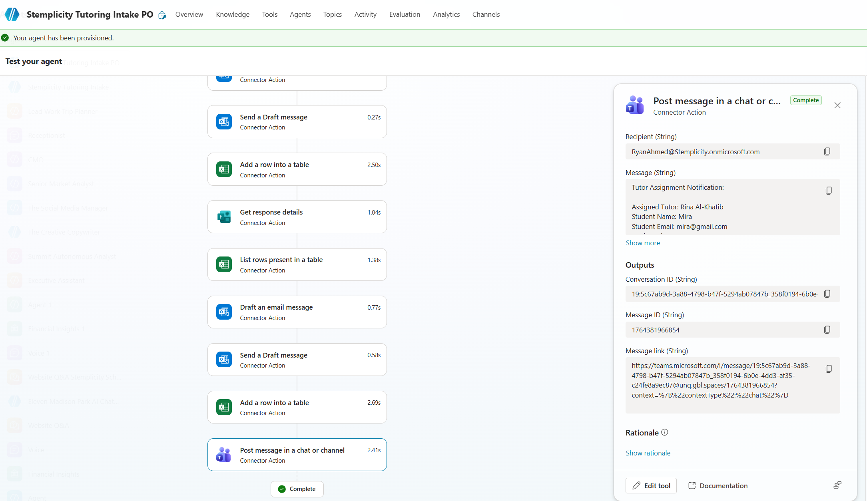
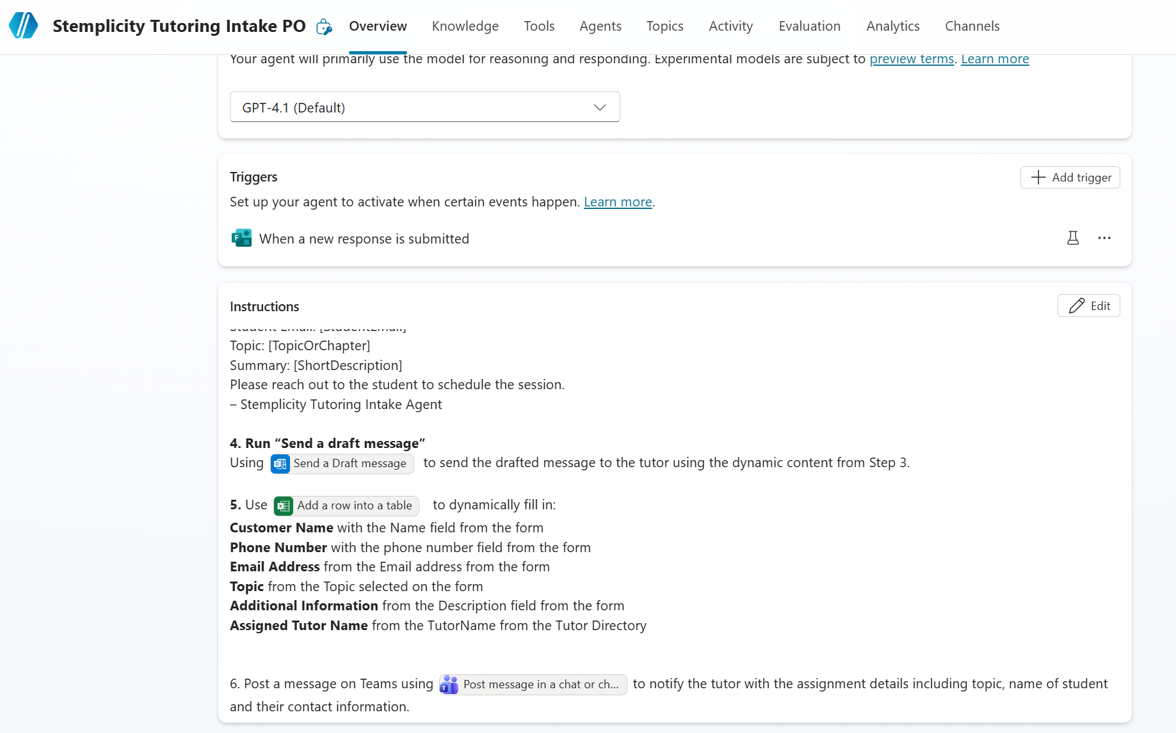
Practice Opportunity Solution
© All rights reserved for Dr. Ryan Ahmed @Stemplicity Inc.

Slide 7
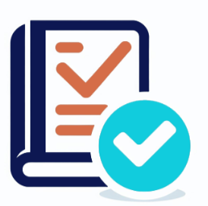
Summary
Gained hands-on experience building a fully autonomous AI agent inside Copilot Studio.
Learned how to connect multiple Microsoft 365 tools (Excel Online, Outlook, Forms) to create multi-step, cross-app automations.
Understood how to write advanced instructions using tool references to control the agent’s behaviour with precision.
Explored how to automate drafting and sending emails using Copilot Studio workflows.
Practiced building automations that update Excel files stored on OneDrive without manual intervention.
© All rights reserved for Dr. Ryan Ahmed @Stemplicity Inc.

Slide 8
Thank you!

